Slide 1
EHS Weekly Meeting
Contents
Ⅰ. Work in progress

Slide 2

EHS related reporting
No. | Contents | Progress | Other
1 | Hazard Identification | 4th 7 out of 9 improvements completed (Aug 20 to the end of Nov) 5th 9 out of 9 improvements completed (Nov 18 to the end of Dec) 6th 24 out of 26 improvements completed (Jan 1 to the end of Feb) 7th 14 out of 9 improvements completed (In progress rate 64%) 8th 13 out of 2 improvement completed (in progress rate 16%)
2 | EHS KPI F/up | FY2526 Explain targets to each department FY2526 April updated and KPI activities Request F/Up from each department
3 | Health initiative ideas | Walking Challenge (All JEO Employees) From May to Aug Strengthen employee management of hypertension from Apr 17 : Blood pressure monitoring follow-up and counseling
4 | Safety Campaign | Preparation for Safety Campaign Activities
5 | Issues Related to I-REC | Notification from the TI Group on the Inability to Issue I-RECs Due to a Policy Shift in China

Slide 3
total | complete | in progress | Progress
14 | 9 | 6 | 64%
◈ Progress of the 7th improvement project
Base Date : 3/1 ~ 5/E
No. | Improvements | Improvement Department | Improvement date | result | proponent
1 | Production 2P. Manual impregnation steam generator (2nd improvement ) Improvement of oil vapor generated from the filter has been completed , and oil vapor generation has been confirmed at the inlet side dust collector primary filter completed (5/8), replacement scheduled (5/9) | Process technology | 5/9 | complete | Composition source
2 | Production 1P. Risk of falling and musculoskeletal disorders due to wheel failure 1st : Check for damaged bogies Constantly improving | Production 1P. | - | Ongoing progress | Lee Ki-hwan , Park Eun-soo , Kim Jin-seong , Yang Yong-mo
3 | Production 1P. 2P. Band show Work- related issues (2nd improvement history ) → Request for change in work standards | Quality Control |  | in progress | Jo Jeong-yu , Lee Jin-ho , Jeong Won-cheol , Kang Jin-ha , Choi Woo-seok
4 | Production 1P. Risk of collision due to frequent breakdown of rear access door in processing Application of 1st sample construction ( processing ), 2nd enlargement ( molding , mold ) expected | Management Support | 4/21 | complete | Kim Kyung-cheol
5 | Production 1P. Auxiliary hook for powder transfer is not fixed due to breakage Auxiliary Hook Replacement | Production 1P. | 3/19 | complete | Jo Seong-geun , Kim Seung-hyeok
6 | Production 1P. Regular Instability of the support plate on which the turntable side tray is placed ( risk of tray falling ) | Production 1P, Conservation |  | in progress | Kim Yeon-gyu , Kang Hong-gyu
7 | Production 2P. Slippery floor due to leakage from automatic impregnation machine Strengthen cleaning cycle and provide caution education as leakage level is at a micro level | Production 2P. Process technology | TBD | complete
8 | T/B pad misalignment occurs, the robot does not stop and continues to operate. | Process technology , production 1P. |  | in progress | Kim Il-hyun
9 | for the pressurized chamber is too high to secure visibility. | Production 1P. | 3/20 | complete | Hong Jeong-woo
10 | Production 1P. When using air blow of the automatic tray feeder, a lot of anti-rust oil is blown away. | Process technology |  | in progress | Kim Young-hwan , Park Hee-chang
11 | Production 1P. When setting up the molded YZK200 , go up on the rail and work ( step is required ) | Production 1P. | 3/19 | complete | Heo Se-young
12 | Production 2P. Molding The powder rack is high, so you have to stand on the railing to proceed with the work. Training operators to remove hooks without climbing onto railings | Production 2P. | 5/8 | complete | Lee Myeong-seop , Kim Young-ho
13 | Production 2P. Pull the crane when moving the molding leak powder disposal mat. Requesting transfers and training operators using lifts | Production 2P. | 5/8 | complete | Joo Jang Hyun
14 | Production 2P. Risk of product tipping over | integrity |  | in progress | Park No-seon

Slide 4
total | complete | in progress | Progress
13 | 2 | 11 | 15%
◈ Progress of the 8th improvement project
Base Date : 5/1 ~ 6/E
No. | Improvements | Improvement Department | Improvement date | Result | Proponent
1 | Risk of collision with forklift during import inspection | Quality Control |  |  | Yoo Cheong-san , Park Min-sik
2 | Production 2P. Risk of collision when operating forming cranes simultaneously ( Check for presence / absence of crane collision prevention device ) → Confirm that collision prevention limit switch can be installed ( prepare measures to address problems caused by installation ) | Management Support | 5/E |  | Min-Hwan Eom
3 | DKS30/1 Pre-pressure loss requires | Production technology | 3/25 | complete | Yang Min-gyu
4 | Use Shinna to clean while working on finding | Director Kim Young-ho |  |  | Production 1P. Regular
5 | Risk of tipping over due to wheel failure of automated devices ( scale cylinder, etc. ) | Production 1P, Production Technology |  |  | Park Myeong-su
6 | Production 1P. Chips fly out when grinding the byte in processing → Completed agreement on wearing safety glasses and providing safety masks | Management Support | 4/10 | complete | Lee Sang Hyun
7 | Production 1P. When crushing a molded defective product, the product pops out ( needs confirmation , areas for improvement ) | Production technology |  |  | Composition Geun
8 | Production 1P. Molding CIN200/1, CIN500 in operation Excessive generation of | Production technology |  |  | Joo Won-gyu
9 | Production 2P. 2. A lot of glass powder from the half bead flies | Production 2P |  |  | Kim Dong-kwan
10 | When replacing the public / maintenance TPA800 hydraulic hose and coupling Risk of falling due to lack of work space other than | Production technology |  |  | The most down
11 | Production 1P. Molded KTM 130 step Slip-resistant wear and tear | Production 1P |  |  | Hwangbo In
12 | Production 2P. Molding TPA 800 ton hydraulic air pump failure, manual hydraulic and air connection, manual movement, trolley rail detached, returned to original position by crane ( content verification required ) | Production 2P |  |  | Lee Dong-young
13 | Production 2P. Fingers caught when automating the molding machine 1 error occurs ( occurs frequently ) | Production 2P. |  |  | Kim Kyu-jin
e

Slide 5
FY2526_EHS KPI Status
Safety KIP
Environment KPI
Fire at dust disposal vendor (landfill) → Normal processing from May
KPI | FY2324 | FY2425 | Apr | May | Jun | Jul | Aug | Sep | Oct | Nov | Dec | Jan | Feb | Mar
Landfill | 16.8% | 8.8% | 26%
e

Slide 6
JEO Safety and Welbeing month _ All Together For Safety
Campaign Promotion
In-depth Analysis of Accident Causes
VIP Video Broadcast and Posters
- Chaiman / SVP (Operation, HR&EHS) / Translation
- Installation of posters and banners (related to slips, trips, and falls)
Safe Behavior and Safety Training
- 3 years of incident case training
- Strengthening compliance and education based on JEO accident case studies
※ Launch of "Safety Culture" software tool (pilot operation in Europe and Asia)
Accident Improvement Effectiveness Evaluation
- Evaluation of the effectiveness of improving accident cases for 3 years
Safety Improvement Proposals by Process
- Collection of safety improvement suggestions from managers/supervisors
- Implementation of safety improvements by TFT eight times
Assignment of Manager/Supervisor Responsibilities
Wellbeing Activities
Safety Patrol Tours & Safety Meetings
- Daily on-site inspections by managers/supervisors
- Sharing of unsafe cases and safety issues (once per week)
Safety Leadership Awards
- Awards for those who excel in identifying unsafe acts or for outstanding
management of accident prevention
Blood Pressure and Automated Defibrillator Use and
First Aid Training
- Utilization of safety education time

Slide 7
JEO Safety and Welbeing month _ All Together For Safety
Campaign Activity | Sub-Activity | Detail | May |  | June
 |  |  | 3W | 4W | 1W | 2W | 3W | 4W
Campaign Promotion | VIP Video Broadcast & Posters | - Translate video scripts
 |  | - Broadcast in cafeteria
 |  | - Produce and purchase posters
 | Safe Behavior Safety Training (1h) | - three years of accident case training - Case-based safe behavior training
Manager/Supervisor Duties | Safety Patrol & Safety Meetings | - Daily on-site inspection by managers/supervisors - Weekly sharing of unsafe findings
 | Safety Leadership Awards | - Sharing unsafe cases and recognizing best improvement contributors
Accident Root Cause Analysis | Evaluation of Effectiveness of Accident Improvement | - Effectiveness Evaluation of TFT Incident Case Improvement
 | Proposals for Safety Improvement by Process | - Collecting and implementing 9th of improvement suggestions from managers/supervisors
Wellbeing Activity | Blood Pressure, AED, First Aid (1h) | - Conducting regular safety guard training time utilization training
e

Slide 8
▣ Renewable Energy Sourcing Methods
How to achieve renewable energy
Source of RE | I-REC (International Renewable Energy Certification) | K-REC (Korea Renewable Energy Certification) | Third-party PPA (Power Purchase Agreement) | Green Premium
Contents | Purchasing I-RECs Issued by Renewable Energy Generating Units | Purchasing I-RECs Issued by Renewable Energy Generating Units | Contract with RE producers through KEPCO to supply RE power | Verifying Renewable Energy Certifications through Investment (Korea Policy)
Unit price | 0.3USD/MWh (Yearly) | 53.57USD/MWh (Yearly) | 104.3USD/MWh (20 ~ 30-year contract ) | 6.95USD/MWh (Yearly)
Supplier | TI Group (China) | Korea Energy Agency | Korea Electric Power Corporation Need to RE Power Plant Contracts | Korea Energy Agency
Advantages | Global I-REC Recognition CDP, Ecovaids, JE Policy, etc. | K-RE100 (RE, GHG) Recognition | K-RE100 (RE, GHG) Recognition | K-RE100 (RE, GHG) Recognition Bidding Methods
cons | K-RE100 Not Recognized Domestic customers not recognized | High unit cost | High unit cost Fewer power plants | GHG Not Recognized
Provisional budget (29,529 MWh) | 8,859USD | 1,581,911USD | 3,079,875USD (Calculate lowest price, excluding other fees) | 295,115USD
TI Group I-REC not available for purchase
Notes:
So in EH&S, we explained the different methods, and as you can see, we talked about I-REC, K-REC, PPA, and Green Premium. These are not the only ways to procure renewable energy. but there are some that don't fit our needs. For example, investing directly in solar and installing it on your roof, which is not easily accessible due to the high cost, labor and skills required.I didn't follow up with Joseph in India on some of the things you mentioned last week, but we'll do that soon.The main point is that we believe that it would be too costly to do anything other than I-REC, so we will be purchasing I-REC, and the purchase will be done in December of next year by the production engineering team.

Slide 9
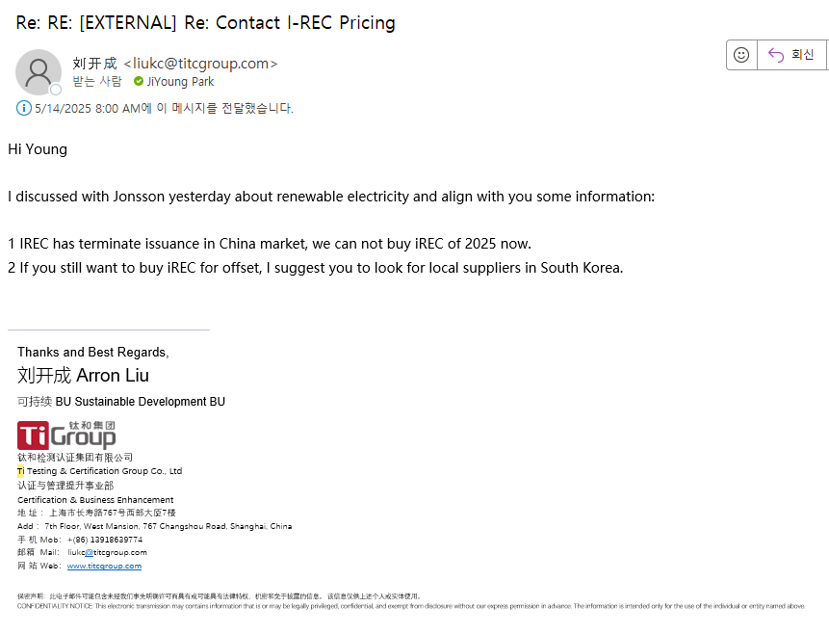
▣ Renewable Energy Sourcing Methods
e

